Slide 1
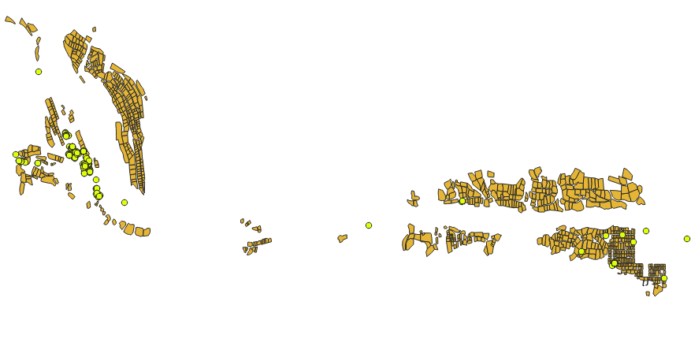
Toshkent viloyati, Angren Shahar, Yangiobod MFY
1207 xonadon
2045 respondent

Slide 2
